Slide 1
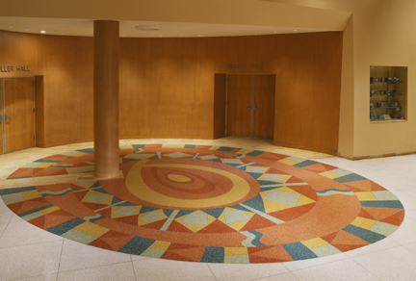
Production and Installation of Terrazzo Flooring
Group #8: Barrett Burgdahl, Clayton Guillory, Hillare Lafond, Erin Mitchell, Daniel Thomas

Slide 2
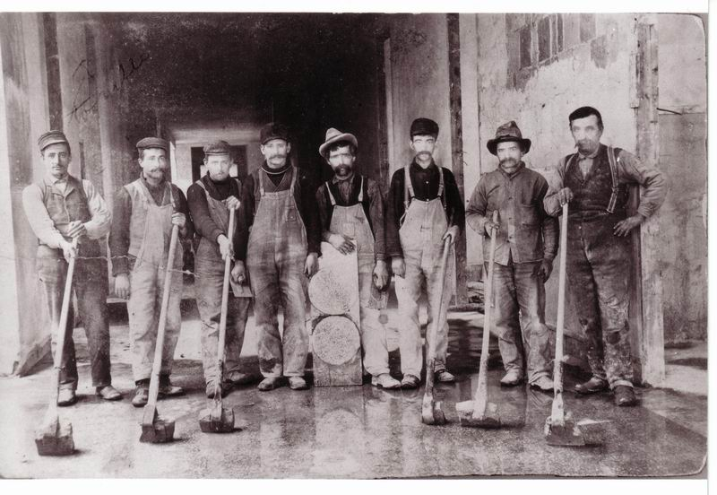
History of Terrazzo Flooring
Comes from the Italian word for “terraces”
Invented in Europe from discarded pieces of marble
Hand stones / Galena – original polishing materials
Goat Milk was the first sealer used

Slide 3

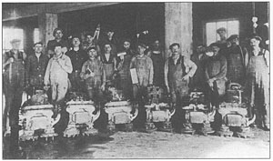
Terrazzo In America
Arrived In late 1700’s
Mount Vernon was one of the first places to feature terrazzo
Influx of Craftsman
Electric Grinders came about through 1920’s technology

Slide 4

Purpose of Terrazzo
Terrazzo is a Decorative form of Concrete
Durable Marble
Strong Concrete
Architects like the way various colorful designs can be put into terrazzo

Slide 5
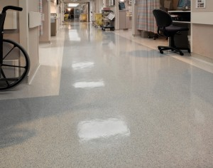
Purpose of Terrazzo
Most common in public buildings but also used in residential
Best choice for a floor that will take heavy abuse (example below is a hospital floor)

Slide 6
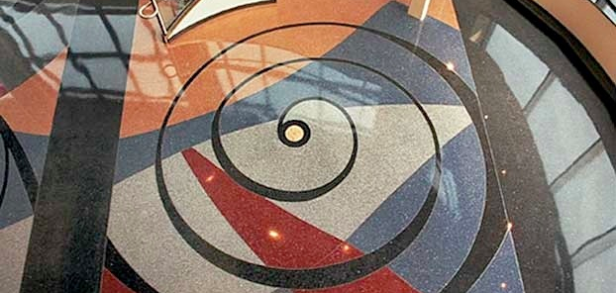
Attributes of Terrazzo Flooring

Slide 7
Attributes of Terrazzo Flooring
Terrazzo Flooring
Aesthetics
Green
Sanitation
Durability
Low Maintenance

Slide 8
Attributes
Aesthetics:
Terrazzo brings design flexibility not available in other flooring systems. It is actually flexible enough to fit even the most complex floor design.
There is also an unlimited color range coupled with a plethora of aggregate options from mother of pearl, to marble, to recycled glass.
“Whether you’re looking for a modern monochromatic look or detailed artistic work with a photographic quality, terrazzo is your canvas.

Slide 9
Attributes
Green:
Terrazzo Flooring possessing a compressive strength of nearly 500 pounds per square inch, some of the earliest terrazzo-like floors created almost 10,000 years ago still exist in the middle east today.
Ancient terrazzo is remarkably analogous to modern cement terrazzo, almost to the point of being indistinguishable. The fact that these floors are still serviceable and beautiful after many centuries is clear confirmation of the superior sustainability of terrazzo.
These floors are even made from all-natural materials; they are completely recyclable so they do their part for the environment.

Slide 10
Attributes
Sanitation:
This non-porous system does not support microbial growth and does not allow accumulation of moisture, absorbing water at a rate 1/10th that of terrazzo which results in an abnormally high stain resistance of the overall system.
This lack of water absorption and porosity results in a surface requiring only minimal cleaning processes, without the need for use of harsh cleaning chemicals.
In addition to them being easy to clean, there are hypoallergenic properties of terrazzo flooring that also make them perfect for those that have difficulties with allergies and sinus problems.

Slide 11
Attributes
Durability:
Ancient terrazzo floors created centuries ago still stand in many buildings throughout Europe, and the middle east Epoxy terrazzo floors are even more durable and can often be expected to outlast the life of the building in which they are installed.
These floors can also be placed in high traffic areas, or commercial buildings, because they are durable enough to last a lifetime.

Slide 12
Attributes
Low Maintenance:
Given the non-porous nature of epoxy terrazzo, only minimal cleaning is required. Unlike carpet, vinyl flooring or tile, a terrazzo floor will almost certainly never need replacement, even when located in high-traffic areas.
There are no grout joints to allow for dirt accumulation. The low maintenance requirements, non-porous nature of the surface and crack-resistance built into the technology used to install Master Terrazzo Technologies floors creates a near-permanent solution that pays for itself over time.

Slide 13
Components of terrazzo flooring

Slide 14
Raw Materials Used
Raw Materials of Terrazzo
  77% of Marble dust and chips
    Marble refers to all calcareous rocks capable of taking a polish
    Marble is quarried, selected to avoid off color or contaminated material, then crushed and washed to be formed into marble chips for terrazzo
    Marble dust is a coproduce of marble chips, not a waste product
  22% of Epoxy Resin
  1% of pigment (titanium dioxide)
  Typical amounts of raw materials used
    3.3lbs of marble dust and .51lbs or marble chips
    1 gal of epoxy resin per 8.5 ft²
    1-15% pigment content, depending on customers wants

Slide 15
Manufacturing Terrazzo
Terrazzo is “manufactured” at the site of installation. The energy requirements for the on-site process include mixing the primer, mixing the terrazzo, grinding the surface (occurs before and after grouting), controlling the dust from grinding, mixing grout, and polishing the floor.
Approximately 1 % of the materials used to make the terrazzo are wasted during manufacturing. This waste is assumed to be disposed of in a landfill.

Slide 16
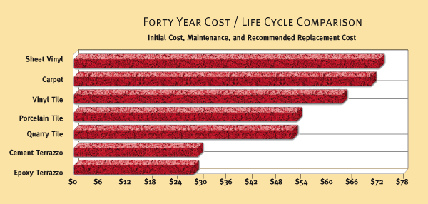
Life Cycle Cost
Developers and builders quickly learn that quality terrazzo flooring not only enhances a building’s image, it appreciates with the value of the investment, and when compared with maintenance and replacement costs over time for alternative flooring systems, terrazzo pays for itself.

Slide 17
Types of Terrazzo
There are six types of Terrazzo tiles:
  Epoxy Terrazzo
  Sand Cushion Terrazzo
  Bonded Terrazzo
  Monolithic Terrazzo
  Polyacrylate Terrazzo
  Rustic Bonded Terrazzo

Slide 18
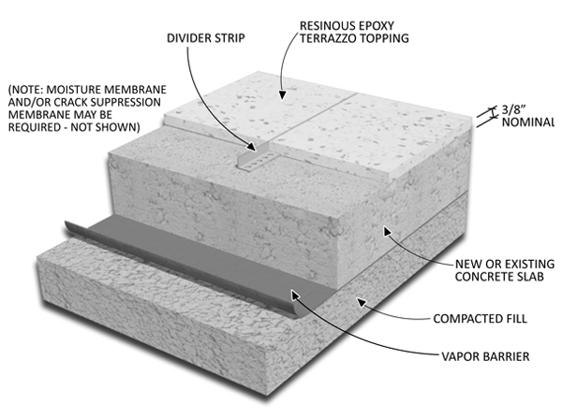
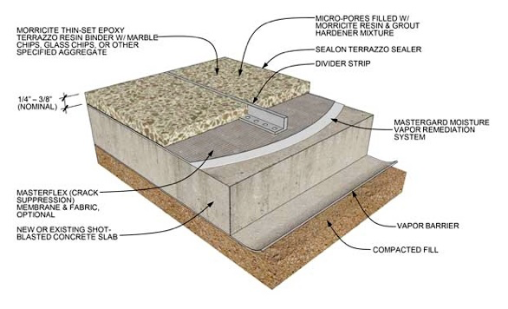
Epoxy Terrazzo
    A nominal 1/4″ or 3/8″ thick resin matrix veneer placed upon a level concrete slab; The best “thin-set” system.
    Advantages:
      Unlimited matrix colors, color control, resiliency, chemical resistance and tensile-compressive strengths not found in cement based systems.
      Excellent for multi-colored patterns and designs.
      Light weight and flexibility make it ideal for multi-story use.
      It has the lowest maintenance cost due to non-absorbency.
      In sanitary areas can be installed with minimal dividers providing seamless characteristics.

Slide 19
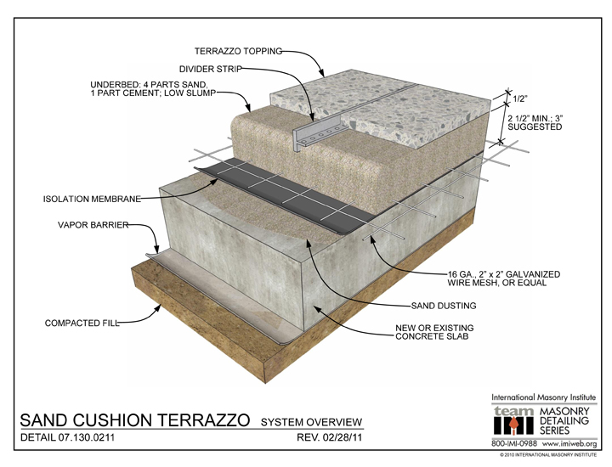
Sand Cushioned Terrazzo
A cement matrix topping under bed with wire reinforcing, isolation sheet, and sand layer system for interior floor use.
This is the best cement system.
Advantages:
  Due to the under bed's depth, wire mesh reinforcing, isolation sheeting and sand layer it will absorb minor substrate defects and prevent mirroring to the surface.

Slide 20
Bonded Terrazzo
A cement matrix and under bed system for interior and exterior areas where conditions require 1.25’ to 1.75’ inches of recessed depth to be filled in addition to the .5’ terrazzo topping.
Advantages: With sand-cement under bed, it has less dependence on the concrete slab for flatness when compared to monolithic.

Slide 21
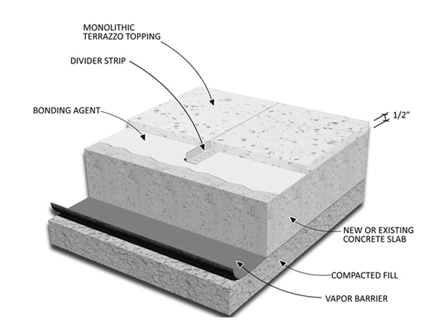
Monolithic Terrazzo
This 1/2″ thick cement matrix veneer placed upon a provided concrete slab is dependent on the concrete quality for flatness and crack prevention.
On grade or below grade only
Advantages:
  Fast installation and the most economical price make it ideal where time and budget are critical but where the beauty, low maintenance and the performance of terrazzo is desired.

Slide 22
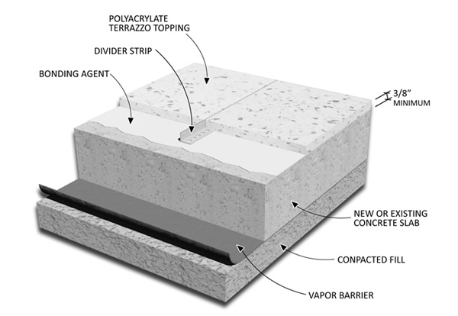
Polyacrylate Terrazzo
    A nominal 3/8″ think polymer modified cement matrix veneer placed upon a provided level concrete slab. Polymer provides strength to allow for thinner applications of cementitious systems.
Advantages:
  Fast installation and moderate price range make it ideal to replace vinyl or carpet without depth transition difficulties
  Good to use in areas subject to moisture vapor transmission where epoxy terrazzo or other non-breathing floors will not adhere.

Slide 23
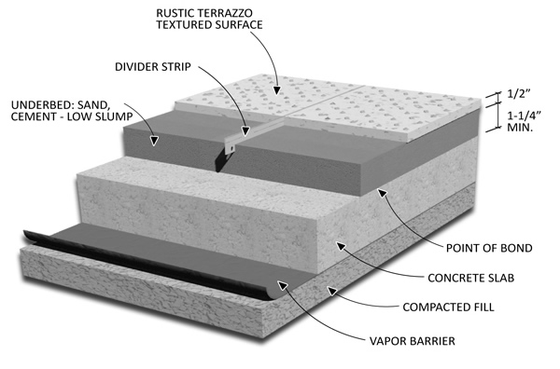
Rustic Terrazzo
    Terrazzo with a non-ground, textured surface, for exterior use.
    This system is available with Bonded and Monolithic Terrazzo.
Advantages
  Infinitely variable textures, colors and patterns may be created in a weather-resistant, skid-resistant deck surface.

Slide 24
Required Equipment
Equipment needed for installing terrazzo flooring:
Shot Blasting
Pressure Washer
Grinder
Adhesives/Hot glue
Wheelbarrow/Cement Mixer
Trowel/Heavy Duty Floor Roller
Stone Floor Grinder

Slide 25
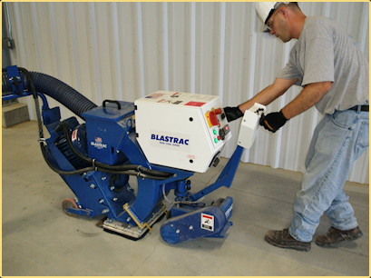
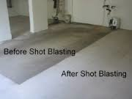
Required Equipment
Shot blasting is used to clear any loose concrete and have a flat even surface to begin working on.

Slide 26
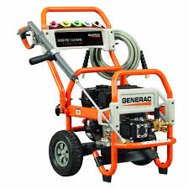
Required Equipment
A pressure washer is used to remove all dirt and allow a clean surface to begin applying membranes and metal tracks.

Slide 27
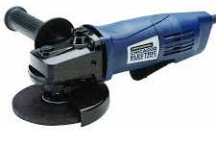
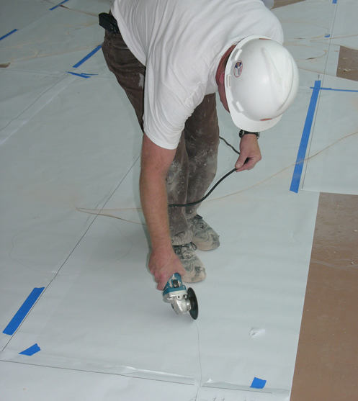
Required Equipment
A Grinder is used to cut the design into the membrane on top of the concrete subfloor

Slide 28
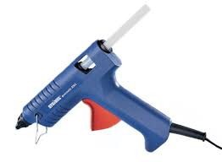

Required Equipment
Hot glue or other adhesives are used to attach the divider strips (made of: aluminum, brass, zinc, or plastic) to the floor.

Slide 29
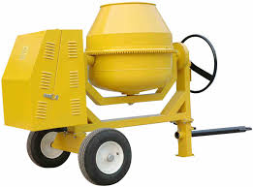
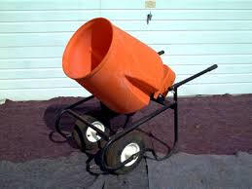
Required Equipment
A wheelbarrow or cement mixer is used to mix the cement with water and the appropriate amount of marble chips/glass/etc.

Slide 30
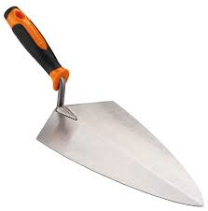
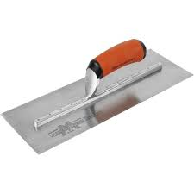
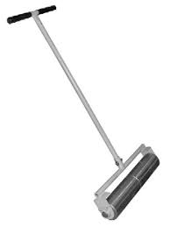
Required Equipment
A trowel or heavy duty floor roller is used to spread the mixture just made (epoxy matrix) across the floor.

Slide 31
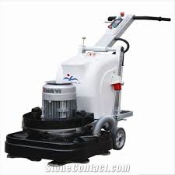
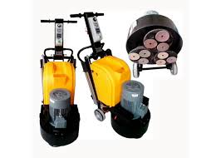
Required Equipment
A stone floor grinder is used to help polish the terrazzo floor along with a grout coat, and a final wax and polish, to give it a nice sealing and shine.

Slide 32
Installation Process
The installation process of terrazzo flooring is an 8 step process consisting of:
  Surface Preparation
  Crack Detailing
  Strip Layout
  Mixing
  Pouring
  Grinding
  Grouting
  Polish and Sealer

Slide 33
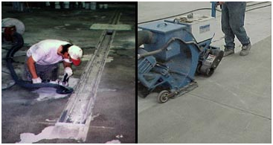
Surface Prep
Prepare a perfectly level, clean, dry, slightly rough surface in concrete 3/4" below the desired finished floor height (5/8" for the tiles and 1/8" for mortar).
Let the concrete slab surface dry completely before installing the cement tiles, otherwise the moisture in the concrete will evaporate through the tiles, resulting in powdery white limestone deposits.
To ensure the longest possible life of the Terrazzo, its best to do proper surface prep and to never lay the cement tile directly onto fresh uncured concrete

Slide 34
Terrazzo Flooring Installation Materials
Installation Materials
  54.4% of Divider Strips (Zinc)
  34.3% Epoxy Resin
  11.3% Acrylic Sealer
To prevent terrazzo from cracking, dividers are placed above any concrete joints.

Slide 35
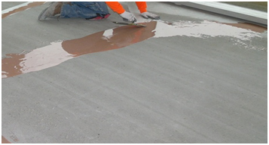
Crack Detailing
To prevent cracking or fracturing from the movement of the substrate and ultimately the earth itself, be sure to include expansion, construction, isolation, contraction, generic and perimeter joints where appropriate.
Wall tile can be installed over drywall, plaster, cement block, cement backer board. The surface should be flat, smooth, and dry and any loose paint should be scraped off and patched.
Clear any loose concrete with shot blasting and mitigate any cracking in the concrete subfloor with a crack suppression system

Slide 36
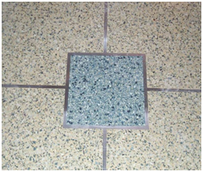
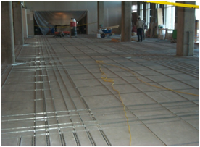
Strip Layout
Strip Layout can be customized to show logos, images and any creative designs.
Utilize a strip for each color change, and then strips as a part of the design, and then control the expansion joints.
Divider strips can be zinc, aluminum, brass or plastic in sizes of 16 ga. (1/16”), 1/8”, 1/4”. The strips should be bonded with adhesive or hot glue.

Slide 37
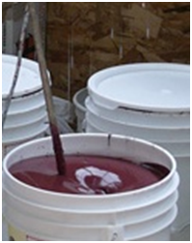
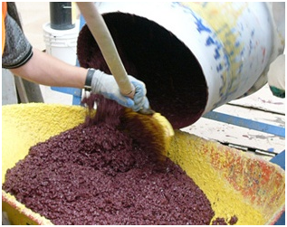
Mixing
Carefully measure out the resin and the hardener into two other containers. You then pour the resin first, add the hardener and then add the powder and aggregates until you get the necessary density.
  Aggregate Types
    Marble
    Granite
    Mother of Pearl
    Glass
    Recycled Glass

Slide 38
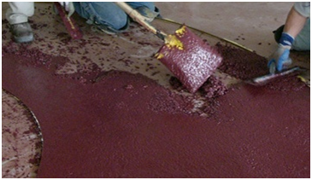
Pouring
In cases where multiple colors are utilized in a small area, such as with a logo, the mixed solution is very carefully transferred from the mixer to the application point.
The epoxy matrix is spread across the membrane with a trowel

Slide 39
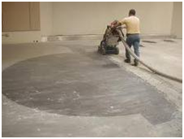
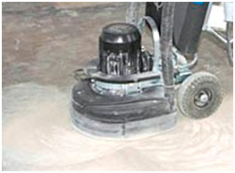
Grinding
Once the floor has cured it can be ground. Grinding of the floor is completed with use of a terrazzo grinding machine which circulates around a dozen small stones or diamond plugs at a high speed.
The grinding process begins with a rougher stone and graduates to smoother stones throughout the process, to achieve a uniform and brilliant surface. In areas where heightened accuracy is required in tight corners, a smaller hand grinding machine is utilized.

Slide 40
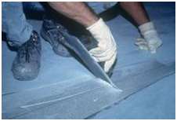
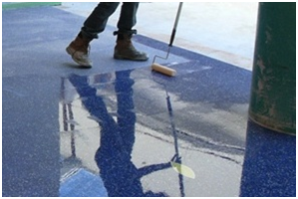
Grouting
An epoxy grout is applied to remove any pinholes after grinding the surface.
Grouting of pinholes is necessary to insure that a non-porous, uniform surface is achieved.
The grout material is epoxy-based and is color matched in the manufacturing process to match the epoxy terrazzo binder.
Completely fill the small gaps between the tiles with grout, using a rubber float. Immediately remove any excess grout with a clean damp cloth or sponge. As you clean the tiles of any grout, you will also be removing the Grout Release.

Slide 41
Polish and Sealer
Apply a high quality penetrating sealer for cement and concrete tiles and carefully follow the sealer manufacturer's instructions. Do not place anything on the tile until the sealer is completely dried per manufacturer's instructions.
If desired, buff the tiles with the floor polisher and white pad using a back and forth motion. This will give your tiles the shine desired. Do this step as long as you like.

Slide 42
Sequence
To view a time lapse of the entire process of installing Terrazzo floors please click the link below.
https://www.youtube.com/watch?v=VvuzZ3ZRNlw

Slide 43
End Result
The purpose of following this 8 step process is to ensure that the flooring wont change with the weather and to increase the longevity of the terrazzo’s life.
The length of time for the terrazzo’s installation can vary with from contractor and the size of project but it generally can be completed within eight days.
  The installation of cementitious terrazzo takes about 4 times as long as installation of epoxy terrazzo.

Slide 44
Safety & Codes

Slide 45
Safety & Codes
Volatile Organic Compounds (VOC)
- What are VOCs, what are the health effects from exposure, and how are workers exposed to VOCs during installation
Occupational Safety and Health Administration (OHSA)
- What is OHSA and what are a few safety standards required during terrazzo flooring installation
ASTM International (American Society for Testing Materials)
- What is ASTM International and what is construction standard required during terrazzo flooring installation

Slide 46
Volatile Organic Compounds (VOC)
Short term exposure:
Can cause headaches, dizziness, light headedness, nausea, eye irritation, and respiratory irritation
Long term exposure:
Can lead to cancer and affect the liver, kidney, and nervous system. Also in some cases, it can contribute to an illness known as sick building syndrome.

Slide 47
Volatile Organic Compounds (VOC)
During the installation of terrazzo flooring, employees will be exposed to VOCs from adhesives and sealers used during the installation process.
Good ventilation and air-conditioning systems are helpful at reducing VOCs in the indoor environment. Employees should open windows and doors or the use of an exhaust fan to increase ventilation and reduce VOC levels within the area.
Repeated or prolonged ventilation may be necessary due to VOCs being released slowly over time.

Slide 48
OSHA
There are a few major standards that workers must follow to ensure that they are maintaining a safe working environment. Two of these standards are:
1926 Subpart D - Occupational Health and Environmental Controls, Section Number 1926.57 (Ventilation)
1910 Subpart O - Machinery and Machine Guarding, Section Number 1910.215 (Abrasive wheel machinery)

Slide 49
OSHA
There are a few major standards that workers must follow to ensure that they are maintaining a safe working environment. Two of these standards are:
1926 Subpart D - Occupational Health and Environmental Controls, Section Number 1926.57 (Ventilation)
1910 Subpart O - Machinery and Machine Guarding, Section Number 1910.215 (Abrasive wheel machinery)

Slide 50
OSHA
1926 Subpart D - Occupational Health and Environmental Controls, Section Number 1926.57 (Ventilation)
This section details the OSHA standards and official letters of interpretation of the standards relating to ventilation. When ventilation is used as an engineering control method, the system shall be installed and operated according to the requirements of this section. When hazardous substances exist or are produced in the course of construction, this section will contain information on the concentrations levels that hazardous substances shall not exceed.

Slide 51
OSHA
1926 Subpart D - Occupational Health and Environmental Controls, Section Number 1926.57 (Ventilation) Cont.
Included in this section are:
design and operation requirements
the duration of ventilation operations
details on what is considered “breathable dust”
required personal protective equipment used during operations
ventilation requirements for surface coating operations

Slide 52
OSHA
1910 Subpart O - Machinery and Machine Guarding, Section Number 1910.215 (Abrasive wheel machinery)
This section details the OSHA standards and official letters of interpretation of the standards related to abrasive wheel machinery safety. It will contain information about the required mechanical design for abrasive wheel machinery, safety guard design and requirements, essential personal protective gear (PPE), work rests, grinding wheel speed, and inspection guides.

Slide 53
ASTM International
There are a few ASTM references that can be utilized during the installation of terrazzo flooring. One of them is ASTM F710-11 Standard Practice for Preparing Concrete Floors to Receive Resilient Flooring.
ASTM F710-11 covers the procedure for determining whether concrete floors are acceptable for the installation of resilient flooring, in this case terrazzo flooring. It will provide ways to ensure that concrete flooring meets the acceptable requirements. Also, it will cover the necessary preparation of concrete floors prior to the installation of resilient flooring.

Slide 54
WORKS CITED
“The Benefits of Terrazzo Flooring.” Master Terrazzo Technology. Master Terrazzo Inc., 2013. Web. 24 November 2015.
“Terrazzo Flooring Pros and Cons.” Your Home and Improvement & Lifestyle Guide. YourCityResource.com, 2011. Web. 24 November 2015.
"How to Install Terrazzo?" Cabella Stone. Cabella Stone Corp., n.d. Web. 30 Nov. 2015.
"CCIS Terrazzo Installation." Scott Parsons. N.p., 17 Nov. 2009. Web. 30 Nov. 2015.
"How to Lay Terrazzo Floors | DoItYourself.com." How to Lay Terrazzo Floors | DoItYourself.com. N.p., n.d. Web. 30 Nov. 2015.
"Patent US8033079 - Method of Manufacturing Terrazzo Tiles, Terrazzo Tiles and Flooring System Assembled with Terrazzo Tiles." Google Books. N.p., n.d. Web. 29 Nov. 2015.
"Installing Terrazzo Tiles - How to Install Thin Terrazzo Tile." Installing Terrazzo Tiles - How to Install Thin Terrazzo Tile. N.p., n.d. Web. 29 Nov. 2015.
"Types and Systems | National Terrazzo and Mosaic Association." Types and Systems | National Terrazzo and Mosaic Association. Web. 1 Dec. 2015.

Slide 55
Works Cited
"Epoxy Terrazzo | National Terrazzo and Mosaic Association." Epoxy Terrazzo | National Terrazzo and Mosaic Association. Web. 1 Dec. 2015.
"Sand Cushion Terrazzo | National Terrazzo and Mosaic Association." Sand Cushion Terrazzo | National Terrazzo and Mosaic Association. Web. 1 Dec. 2015.
"Bonded Terrazzo | National Terrazzo and Mosaic Association." Bonded Terrazzo | National Terrazzo and Mosaic Association. Web. 1 Dec. 2015.
"Monolithic Terrazzo | National Terrazzo and Mosaic Association." Monolithic Terrazzo | National Terrazzo and Mosaic Association. Web. 1 Dec. 2015.
“Polyacrylate Terrazzo | National Terrazzo and Mosaic Association." Monolithic Terrazzo | National Terrazzo and Mosaic Association. Web. 1 Dec. 2015.
"Rustic Terrazzo | National Terrazzo and Mosaic Association." Rustic Terrazzo | National Terrazzo and Mosaic Association. Web. 1 Dec. 2015.
"Generic Terrazzo." http://nist.gov/. Web. 1 Dec. 2015. <http://ws680.nist.gov/bees/ProductListFiles/Generic Terrazzo.pdf>.
"Master Terrazzo | Frequently Asked Questions." Master Terrazzo FAQs Comments. Web. 1 Dec. 2015.

Slide 56
Works cited
"ASTM F710 - 11 Standard Practice for Preparing Concrete Floors to Receive Resilient Flooring." ASTM F710 - 11 Standard Practice for Preparing Concrete Floors to Receive Resilient Flooring. Web. 1 Dec. 2015.
"ASTM International - ASTM Fact Sheet." ASTM International - ASTM Fact Sheet. Web. 1 Dec. 2015.
"Detailed Overview." ASTM International -. Web. 1 Dec. 2015.
Wikipedia. Wikimedia Foundation. Web. 1 Dec. 2015. <https://en.wikipedia.org/wiki/ASTM_International>.
"Volatile Organic Compounds (VOCs) in Commonly Used Products." Volatile Organic Compounds (VOCs) in Commonly Used Products. Web. 1 Dec. 2015.
Wikipedia. Wikimedia Foundation. Web. 1 Dec. 2015. <https://en.wikipedia.org/wiki/Volatile_organic_compound#US>.
Wikipedia. Wikimedia Foundation. Web. 1 Dec. 2015. <https://en.wikipedia.org/wiki/Sick_building_syndrome>.
"Tox Town - Volatile Organic Compounds (VOCs) - Toxic Chemicals and Environmental Health Risks Where You Live and Work - Text Version." Tox Town - Volatile Organic Compounds (VOCs) - Toxic Chemicals and Environmental Health Risks Where You Live and Work - Text Version. Web. 1 Dec. 2015.
"About OSHA Page." About OSHA Page. Web. 1 Dec. 2015.

Slide 57
WORKS CITED
"Abrasive Wheel Machinery." Occupational Safety & Health Administration. Web. 1 Dec. 2015.
"Ventilation." Occupational Safety & Health Administration. Web. 1 Dec. 2015.
"Safety and Health Topics | Ventilation." Safety and Health Topics | Ventilation. Web. 1 Dec. 2015.
"Safety and Health Topics | Concrete and Concrete Products - Manufacturing and Construction - OSHA Standards." Safety and Health Topics | Concrete and Concrete Products - Manufacturing and Construction - OSHA Standards. Web. 1 Dec. 2015.

